Slide 1





Historical Perspective
Unit I

Slide 2
At the end of this unit students will be able to:
By the end of the unit, the student will be able to:
Explore the region of Indo Pakistan subcontinent and its earliest civilization
Explain different phases of the arrival of Muslims in India and formation of Muslim community
Identify the significant aspects of Muslim community.

Slide 3
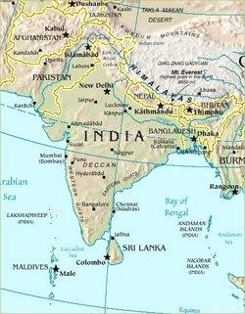
India

Slide 4
Ancient India
Names: Hindustan, Bharat, India, Indo Pakistan Subcontinent
Peninsula
Three geographical regions
Hindustan North, Deccan , Tamil in south
Centre of World oldest civilization, Indus valley Civilization
Hinduism world ancient religion
Centre of three religions, Hinduism, Jainism and Buddhism

Slide 5
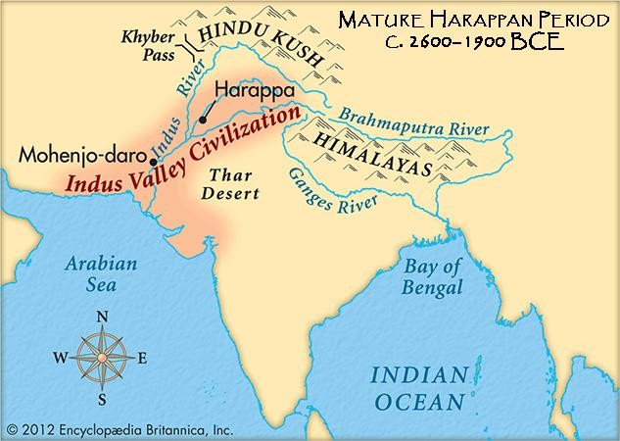
Indus Valley Civilization (5000)

Slide 6
Significant aspects of Indus Valley civilization
Two main cities Harappa and Mohenjodaro
Town planning
Seals
Way of life
Peace loving
According to some scholars this civilization was destroyed by Aryans, the nomads who came from central Asia

Slide 7
The era that followed after the Aryan triumph over the Indus people is called the Vedic period, it was the beginning of Hinduism and Indian civilization
Hinduism have a ssimilative quality (Aryan, Scythians, Parthian, Greeks and other nations came India and gradually absorb in Hindu identity except Muslims
Unity in diversity

Slide 8
Hinduism
Polytheist
Idols worship
Nature worship
Caste system
Brahmin (Priests and educators) Kshatriya (Warriors)
vaishya (Cultivators and traders) Shudra,
Harijan (untouchable or out caste)

Slide 9
Arrival of Muslims in Indo Pakistan Subcontinent
Three Phases
South India
First Muslim colony of traders were in South India. Arab traders had trade links with India before Islam and they had monopoly on sea routs.
Sind
During Umayyad rule , Governor of Iraq Hajjaj Bin Yousf had conflict with the rule of Sind Raja Dahir on the issue of looting of Arabs ship by Sind pirates result was attack of Muhammad bin Qasim on Sind at 712 AD. Sind became a province of Muslim Empire.

Slide 10
Cont---
3. North western side
Ruler of Ghazna (Afghanistan) Mahmud Ghaznavi attacked on India and his seventeen attacks are famous in history during the time period of 1005-1025. Punjab became a province of Ghazni Empire. Rival of Ghanavid, Muhammad Ghori defeated them and succeeded in capturing Punjab and further moved inside India. After his death his General Qutb-ud-Aibak announced his kingship on India in 1206 AD. After that Muslim Families ruled on India till 1857.

Slide 11
Spread of Islam in Subcontinent
Migration
Many Muslims from Arab, Central Asia, Afghanistan and Iran were settled in subcontinent.
- For better opportunities
took shelter from the war ridden areas of Muslim world at the time of attack of Halaku
large number of Iranian came with Mughal ruler Hummayun.
Intermarriages
Muslim immigrants married native women.

Slide 12
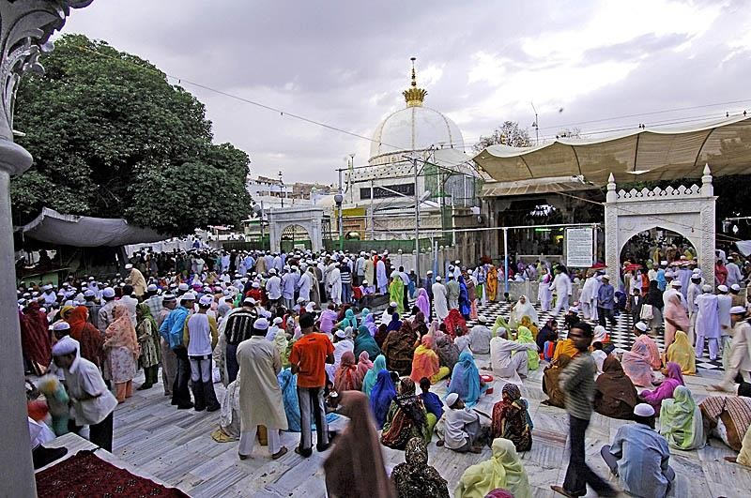
Cont---
3. Conversion
Sufis played important role in the spread of Islam in India. Large number of Hindus convert to Islam due to the peaceful way of preaching.

Slide 13
Challenges faced by Muslims and their Responses
1. Fear of losing religious identity
Response
Revivalist and Reformist movement, reminding of Muslims their basic Islamic teachings.
Emphasis on Islamic values
Feeling of separate identity which promote unity among them

Slide 14
Cont--
2.Feeling of insecurity (being in minority)
Response
Welcome Muslims of other regions (Muslim world)
Policies of Muslim rulers for gaining the cooperation and support of Hindus.

Slide 15
Cont--
3.Fear of loosing cultural identity
Responses
Promotion of Islamic cultural identity
Evolution of new culture with the integration of Arab, Central Asian, Iranian and native cultures

Slide 16
Factors behind the formation of Muslim community
Believing on Islam
Feeling of insecurity which helped developing unity among Muslims of diverse racial and cultural background
Distintive Muslim culture and society which evolved with the interaction of Turko Iranian and Native culture

Slide 17
Result
Both Hindu and Muslim communities lived side by side, had peaceful
interaction, made impact on each other
but
There were occasions of tension and conflicts

Slide 18
SUFISM (ISLAMIC MYSTICISM)
Sufis are mystics who aim for a closer union with God. They played important role in the spread of Islam in India They had following features
• Against worldly attitude of people emphasized simple way of life
• Passionate feeling of love for God
• Meditation for spiritual enhancement
• Deep sympathies for masses
• No discrimination of people on the basis of religion, class race etc
• Deep humanitarian approach

Slide 19
Ali ibn Usman Hujwiri or Data Ghung Buksh (d 1072 AD at Lahore) was known as a first important sufi who settled in India
Writer of first book on Islamic Mysticism Kashf- ul- Mahjub
Some famous Sufis
Khawaja Minuddin Chishti Ajmeri • Farid-ud-din Gang-i-Shakar • Bahktiyar Kaki • Baha-ud-din Zakariya

Slide 20
Revivalist & Reformist Movements
Meaning of some terms
Revivalism:
Bringing back, tendency to revive what belongs to the past
Reform:
Form again, improvement or amendment of what is wrong or corrupt

Slide 21
Prominent thinkers
Sheikh Ahmad Sirhindi
1564 – 1624 AD
Popularly known as Mujadid Alf Sani (Reformer of the second Millennium
He wrote letters to Mughal ruler Jahangir for revival of Islam.

Slide 22
Shah Waliullah
1703- 1762
Period of Mughal decline, chaos India
He translate Quran in Persian language
Tried to make a bridge between diverse religious groups.
Invited Ahmed Shah Abdali to India for defeating Marathas.

Slide 23
Syed Ahmad Shaheed Barelvi
1786 – 1840
Syed Ahmad Shaheed movement is also known as Mujahideen movement
War against Sikh ruler Ranjeet Singh and centre of war Balakot.

